Slide 1
Income prediction
By Akhilesh mishra

Slide 2
Steps in data Analysis
Load data
Clean data
Data modification
Apply feature engineering
Do visualization Analysis
Build models
Accuracy observed.

Slide 3
About data set
In this data set , this shows the annual incomes of people from 42 different countries but the majority is dominated by the united states and then by few percent with Mexico and rest by Other 40 countries.
The data set contain id , age , work class ,education ,marital status , occupation , relationship, race , gender etc
This dataset is for predicting income those having less than or greater than 50 k.

Slide 4
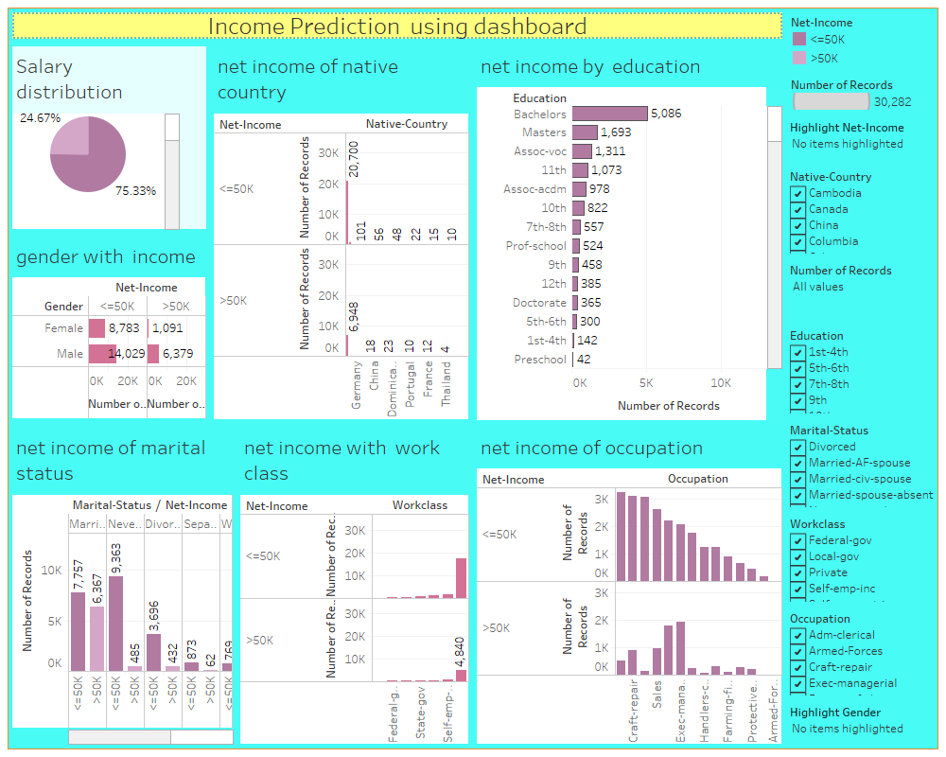
Income prediction dashboard

Slide 5
modelling
Logistic regression - 80.45%
Decision Tree – 80.70%
kNN –81.59%
Random forest – 96.85%

Slide 6
Thankyou

